Slide 1
Multi- class classification of breast cancer abnormalities using Deep Convolutional Neural Network (CNN)

Slide 2
Year of publication:
Published: August 26, 2021

Slide 3
The dataset used:
Curated Breast Imaging Subset of Digital Database for Screening Mammography (CBIS-DDSM)
https://wiki.cancerimagingarchive.net/download/attachments/22516629/CBIS-DDSM-All-doiJNLP-zzWs5zfZ.tcia?version=1&modificationDate=1534787024127&api=v2

Slide 4
Data pre-processing:
This step is used to enhance the quality of the image and increase the chance for a better abnormality classification.

Slide 5
CLAHE:
A detailed analysis was conducted in to show the complexities of the applications of preprocessing techniques in different types of medical images and the need for this process. In this work, Contrast limited adaptive histogram equalization (CLAHE) has been chosen as it operates on small region of the breast image rather than the entire image and apply equalization on each of them. In addition, the breast images had less broken lines

Slide 6
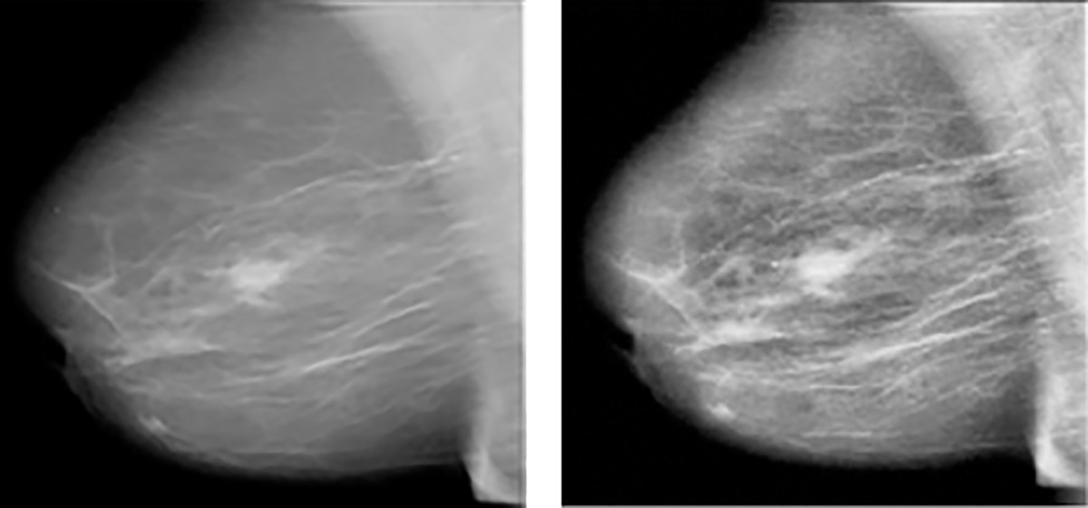
CLAHE
(a) Original Image (b) Image after CLAHE

Slide 7
The implemented algorithms:
A customized dataset is firstly constructed and then the images are pre-processed to remove blurs and noises. A deep convolution neural network has been developed in addition to the application of an existing pre-trained deep learning model. The enhanced model has been tested and evaluated.

Slide 8
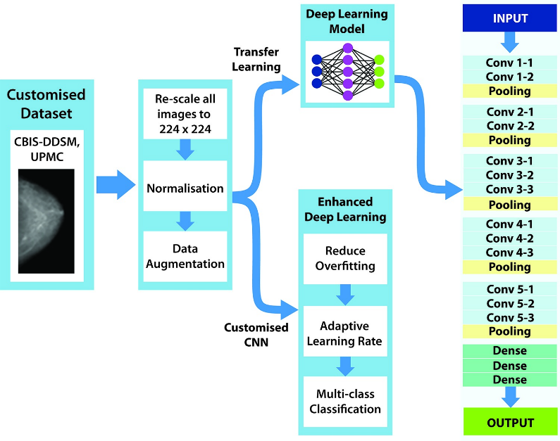
Architecture used in paper:

Slide 9
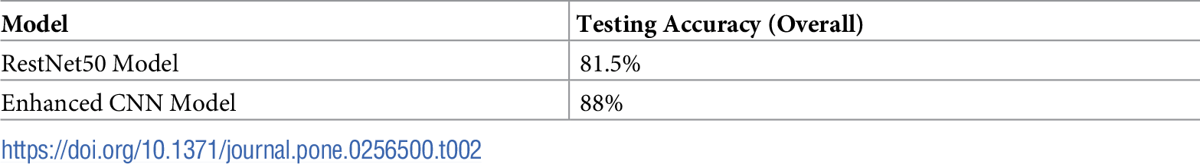
Its results:

